Slide 1
Introduction

Slide 2
Agenda
Introduction of Mobile Technology
Mobile Phone History
Software Technology for Mobile Device
J2ME Overview
  CDC
  CLDC
  MIDP
J2ME Resources

Slide 3
Mobile Technology Overview
The Goals of Mobile Technology
  Connecting people
  Information sharing
  Internet access
  Entertainment
key phrase:
“communication any time, anywhere”

Slide 4
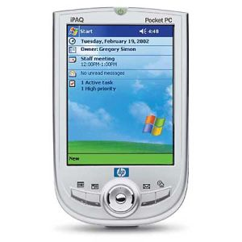
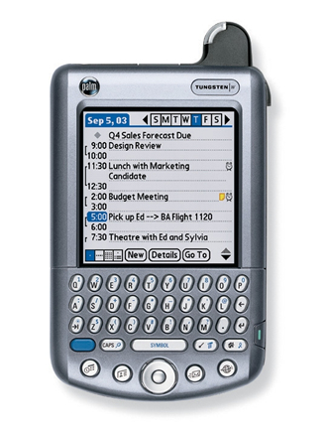
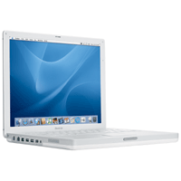
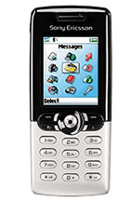
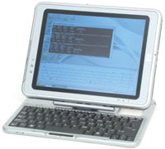
Mobile Technology
Includes
  Notebook
  Palmtops
  PDAs
  Mobile Phones
  Tablet PCs
  And more ...

Slide 5
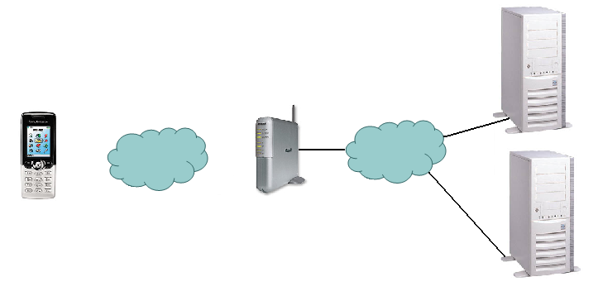
Continued. . .
The Internet Scenario for retrieving information in a wireless network
Base Station
Web Servers
Internet
Wireless Network
Request :
Response :

Slide 6
Continued. . .
Mobile Networking
  GSM, GPRS, EDGE
  1G, 2G, 2.5G, 2.75G, 3G and 4G
  IEEE802.11
  InfraRed and Bluetooth

Slide 7
Current Technology
GSM
  Short for Global System for Mobile Communications, one of the leading digital cellular systems. Data speed for GSM is 9.6 kilobits.
EDGE
  Enhanced Data GSM Environment. EDGE is a faster version of GSM wireless service. EDGE enables data to be delivered at rates up to 384 Kbps on a broadband.

Slide 8
Current Technology
GPRS
  Short for General Packet Radio Service, a standard for wireless communications which runs at speeds up to 115 kilobits per second.

Slide 9
Evolution
First Generation (1G)
  Analog system designed for voice only communication. 1G systems are almost extinct now,
Second Generation (2G)
  Use GSM and IS-95 CDMA technologies
  CDMA
    Allows users to communicate with different codes
  Still designed for voice communication

Slide 10
Evolution
2.5 and 2.75 Generation
  GPRS and CDMA2000 (Phase 1) are belonged to 2.5 G
  EDGE is belonged to 2.75G
  As higher data rate is provided, allows some data transmission

Slide 11
Evolution
Third Generation (3G)
  Two 3G, UMTS and CDMA-2000, are used. UMTS is broadly deployed in Europe and CDMA-2000 is being deployed in North American and parts in Asia
  Higher data transmission rate (up to 2Mbps) which allows video conferencing

Slide 12
Evolution
Forth Generation (4G)
  Combined the technologies of Wireless local area network (will be introduced soon) and 3G

Slide 13
Evolution
IEEE802.11
  Wireless Local Area Network
  802.11a, 802.11b and 802.11g
  Allows 54Mbps data transmission speed (even 108Mbps is provided in the market)
  Used for PDA, Notebook or even desktop

Slide 14
Facilities
InfraRed
  Short range data transmission technology
  Normally used as remote controller
  Data rate is around tens kbps
  Line of sight transmission, hence the space between two InfraRed Devices should be clear

Slide 15
Facilities
Bluetooth
  Commonly used for hand-free earphone
  Short range data transmission – around 10 meters
  Data rate is up to 1Mbps
  Do not have light of sight requirement

Slide 16

Mobile Phone History
In1843
  Michael Faraday a talented chemist begins researching the possibility that space can conduct electricity. His research starts the wheels turning for many other 19th century scientists. At the time, many of them were referred to as “crackpots”.
In 1865
  A Virginia Dentist/Scientist, Dr. Mahlon Loomis, develops a method of communicating through the earth’s atmosphere by using an electrical conductor. He does this by flying two kites, that are rigged with copper screens and wires, which are connected to the ground on two separate mountains about 18 miles apart. He later received a grant from the U.S. Congress for $50,000. (A fairly large chunk of change for 1865)

Slide 17
Mobile Phone History
In 1866
  The first trans-Atlantic telegraph is built (not much to do with cell phones, but a major advancement in communication nonetheless)
In 1921
  The Police Department in Detroit, Mich. begins installing mobile radios, operating around 2 MHz, in their squad cars. They encounter many problems such as overcrowding on the channels and terrible interference.

Slide 18
Mobile Phone History
In 1934
  The U.S. Congress creates the Federal Communications Commission. They decide who gets to use certain radio frequencies. Most channels are reserved for emergency use and for the government. Radio is still a baby.
In 1940’s
  The mobile radios are able to operate at 30 to 40 MHz and become much more common between police departments, and the wealthy. Several private companies and organizations begin using these same radios for personal gain.

Slide 19
Mobile Phone History
In1945
  The first mobile-radio-telephone service is established in St. Louis, Miss. The system is comprised of six channels that add up to 150 MHz. The project is approved by the FCC, but due to massive interference, the equipment barely works.
In 1947
  AT&T comes out with the first radio-car-phones that can be used only on the highway between New York and Boston; they are known as push-to-talk phones. The system operates at frequencies of about 35 to 44 MHz, but once again there is a massive amount of interference in the system. AT&T declares the project a failure.

Slide 20
Mobile Phone History
In 1949
  The FCC authorizes the widespread use of many separate radio channels to other carriers. They are know as Radio Common Carriers (RCC) and are the first link between mobile phones and the telephone, rather than just radio to radio. The RCCs are the first step toward the cellular phone industry, which were designed more for profit than for the general public.
In 1956
  The first real car phones, not car radios, come into play across the United States. Although, the system is still using push-to-talk phones, it is an improved version that actually works. However, the units are big and bulky, and require a personal radio operator to switch the calls. A similar system appeared in Sweden a few years earlier.

Slide 21
Mobile Phone History
In 1964
  A new operating system is developed that operates on a single channel at 150 MHz. In essence, this removes the need for push-to-talk operators. Now customers can dial phone numbers directly from their cars. RCCs are finally taken seriously by the FCC as legitimate competitors to the land-line phone companies.
In 1969
  The self-dialing capability is now upgraded to 450 MHz and becomes standard in the United States. This new service is known as (IMTS) Improved Mobile Telephone Service.

Slide 22
Mobile Phone History
In 1970
  Cell Phone lobbyists finally win with the FCC and get a window of 75 MHz in the 800 MHz region, which is allocated specifically for cell phones. The FCC realizes the potential of the industry and can’t ignore it any longer.
In 1971
  AT&T is the first company to propose a modern-day mobile-phone system to the FCC. It involves dividing cities into “cells”. It is the first company to experiment on this.

Slide 23
Mobile Phone History
In 1973
  Dr. Martin Cooper invents the first personal handset while working for Motorola. He takes his new invention, the Motorola DynaTac., to New York City and shows it to the public. His is credited with being the first person to make a call on a portable mobile-phone.
In 1974
  The FCC actually starts to encourage cell phone companies to push forward the “cellular idea”. But unfortunately a law suit arises with Western Electric, who is the closest company to succeed at the time, and it rules that they are not allowed to manufacture terminal and network phone systems under the same roof. This is an effort to prevent a monopoly. But it also prevented progress.

Slide 24
Mobile Phone History
In 1975
  AT&T adapts its own cellular plan for the city of Chicago, but the FCC is still uneasy about putting the plan into action.
In 1977
  Finally cell phone testing is permitted by the FCC in Chicago. The Bell Telephone Company gets the license; they are in a partnership with AT&T which was then, a collaborative effort to battle the stubborn FCC.

Slide 25
Mobile Phone History
In 1981
  The FCC makes firm rules about the growing cell phone industry in dealing with manufactures. It finally ruled that Western Electric can manufacture products for both cellular and terminal use. (Basically they admitted that they have put the phone companies about 7 years behind)
In 1988
  One of the most important years in cell phone evolution. The Cellular Technology Industry Association is created and helps to make the industry into an empire. One of its biggest contributions is when it helped create TDMA phone technology, the most evolved cell phone then. It became available to the public in 1991.

Slide 26
Mobile Phone History
1991-2000
  Marked the appearances of giant cell phone companies like NOKIA and Ericsson. SDMA, GPS, GSM technologies sprouted. This was considered the “golden decade of cellular phone technology”
In 2001
  BellSouth announces that it is leaving the pay phone business because there is too much competition from cell phones.

Slide 27
Mobile Phone Future
2007 and beyond . . .
  A UE CCSS Graduate developed the first all terrain cell phone. The device can be used undersea with depths of 500m, and can still sense signals through 300m of earth (caves) ☺

Slide 28
Software Technology for Mobile Device
There are many platforms around mobile applications development
  Windows Mobile
  Symbian
  Embedded Visual C++ and .Net
  J2ME

Slide 29

Software Technology for Mobile Device
Windows Mobile
  Windows Mobile is Microsoft's software platform for Pocket PCs and Smartphones. Windows Mobile extends the familiarity of the Windows desktop to personal devices.
  Windows Powered mobile devices include Pocket PC, Pocket PC Phone Edition, Smartphone, and Handheld PC

Slide 30
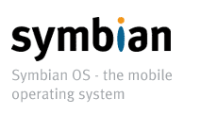
Software Technology for Mobile Device
Symbian
  Symbian is like an Operation System on mobile phone. It provides the required low level functions for application development

Slide 31
Software Technology for Mobile Device
Embedded Visual C++ 4.0 and .Net
  Programming language and related libraries that allows programmer to develop applications on Windows Mobile platform

Slide 32
Software Technology for Mobile Device
J2ME (Java 2, MicroEdition)
  Normally used for less memory and low processing power devices
  A collection of packages and classes for application development on mobile devices
We will use J2ME to develop applications in this course

Slide 33



J2ME Overview
Java
  A programming language developed by Sun Microsystems
  Required a Virtual machine to interpret the source codes and generate bytecodes
  Syntax is similar to C++
  Platform independent feature

Slide 34
J2ME Overview
Java includes three different editions
  J2SE (Java 2 Standard Edition)
  J2EE (Java 2 Enterprise Edition)
  J2ME (Java 2 Micro Edition)
The above three editions target different devices or systems

Slide 35
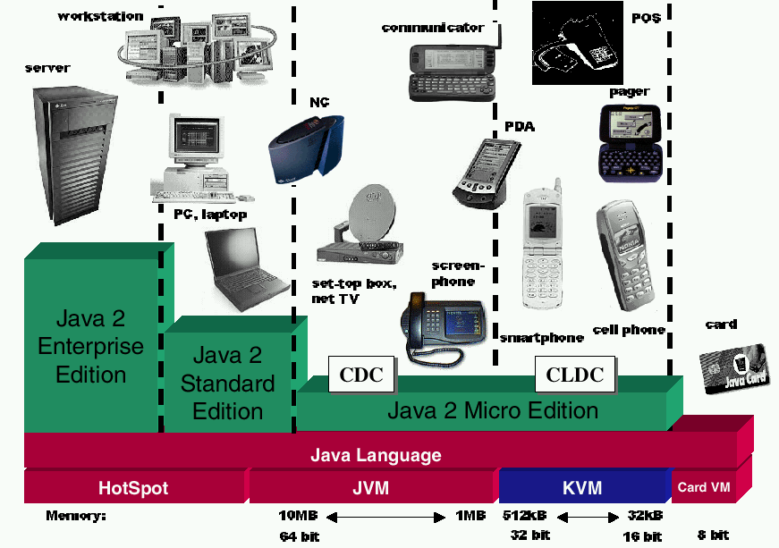
J2ME Overview

Slide 36


J2ME Overview
J2SE
  Provides a complete environment for applications development on desktops and servers
  The foundation of J2EE
  J2SE 1.5 (Tiger) is available now!

Slide 37
J2ME Overview
J2EE
  Targeted for business use
  Large scale systems which may contain hundreds of servers and millions of users
  Web based services
  High performance machines

Slide 38
J2ME Overview
J2ME
  The Micro Edition of the Java 2 Platform provides an application environment that specifically addresses the needs of commodities in the vast and rapidly growing consumer and embedded space, including mobile phones, pagers, PDAs, set-top boxes, and vehicle telematics systems

Slide 39
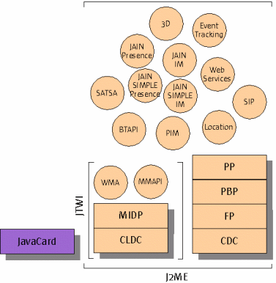
J2ME Overview
J2ME Architecture

Slide 40
J2ME Overview
J2ME architecture is divided in to four different level
  KVM (Kilobyte Virtual Machine)
  Configurations
  Profiles
  Optional packages

Slide 41
J2ME Overview
KVM (Kilobyte Virtual Machine)
  As the name implies, it is used for small program
  A subset of JVM
  A pool for running java code on the device

Slide 42
J2ME Overview
Configurations
  defines a basic, lowest-common-denominator J2ME runtime environment
  includes the virtual machine and a set of core classes derived primarily from J2SE

Slide 43
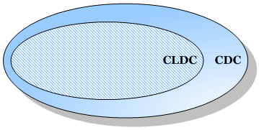
J2ME Overview
There are two different configurations
  Connected Device Configuration (CDC)
  Connected Limited Device Configuration (CLDC)
Relation between CLDC and CDC

Slide 44
J2ME Overview - CDC
Targeted for devices that have
  2 MB or more total available memory
  Memory dedicated to J2ME environment
  More than 2MB ROM/Flash
  More than 512 KB RAM
  Network connectivity
Full Java 2 Virtual Machine specification

Slide 45
J2ME Overview - CDC
CDC uses
  Wireless communicators
  High-end PDAs
  TV set-top boxes
  Gateways
  Automotive entertainment and navigation systems
  Telecomm/Networking Equipment
  Industrial Controllers

Slide 46
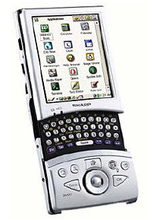
J2ME Overview - CDC
Full-featured Java 2 platform runs on small devices
  Sharp Zaurus can run J2ME CDC

Slide 47
J2ME Overview - CDC
Three profiles build on CDC
  Foundation Profiles (FP)
    Provides core Java functionalities, such as input/output streams, security, networking
  Personal Profiles (PP)
    Support Java Graphical User Interface
  Personal Basic Profiles (PBP)
    A smaller set of Personal Profiles
We will stop at CDC here and focus on CLDC

Slide 48
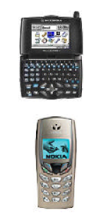
J2ME Overview - CLDC
Targeted at devices with:
  160KB to 512KB total memory available for Java technology
  Limited power (battery), connectivity (often intermittent), UI (small screen)

Slide 49
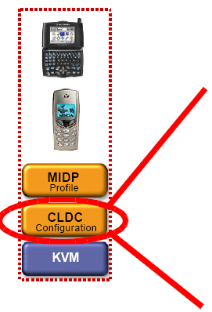
J2ME Overview - CLDC
CLDC scope
Core java.* libraries
Additional I/O and
networking libs
Security features
Internationalization

Slide 50
J2ME Overview - CLDC
Classes extended from Java 2 Platform, Standard Edition (J2SE) are in packages:
  java.lang.*
    Contains the basic Mathematics classes and data types
  java.util.*
    Contains some commonly used functionalities like Random and Vector (store a set of values)
  java.io.*
    Contains the data types for Input/output data
New classes introduced by CLDC are in package:
  javax.microedition.*

Slide 51
J2ME Overview - CLDC
But. . . CLDC is not enough for building applications
CLDC is the base for building the above profiles
It separates the machine dependent issues from the applications

Slide 52
J2ME Overview - CLDC
There are two version of CLDC
  CLDC 1.0
  CLDC 1.1
Today, most mobile phones only support 1.0 version
Main differences between 1.0 and 1.1 are
  Floating point is added in 1.1
  More Date related classes is added in 1.1
  The minimum memory budget has been raised from 160 to 192 kilobytes
  And more …
  [Reference: http://developers.sun.com/techtopics/mobility/getstart/articles/survey/]

Slide 53
J2ME Overview - MIDP
Targets mobile two-way devices implementing J2ME CLDC
Profile addresses
  Display toolkit, User input methods
  Persistent data storage
  HTTP 1.1-based networking using CLDC Generic Connection framework

Slide 54
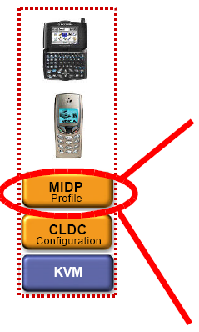
J2ME Overview - MIDP
Scope
Application model
Persistent storage (RMS APIs)
Networking (HTTP, etc.)
User interface (High and low level APIs)

Slide 55
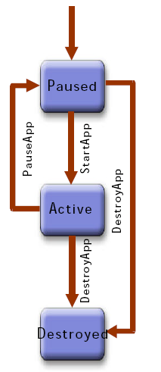
J2ME Overview - MIDP
MIDP Application Lifecycle
  MIDP applications, or “MIDlets”, move from state to state in their lifecycle according to a state diagram
  Paused – initialized and waiting
  Active – has resources and is executing
  Destroyed – has released all resources, destroyed threads, and ended all activity

Slide 56
J2ME Overview - MIDP
MIDlet Packaging
  MIDlets are packaged in a JAR (like a zip file) file including Class files of the MIDlet(s)
  Resource files
  Manifest with application properties
Application Descriptors (JAD files) accompany MIDlet JARs and provide deployment information (name, version, size, etc.)

Slide 57
J2ME Overview - MIDP
MIDlet Development Steps
  Write your Java application
  Compile it
  Preverify it
  Package it into a JAR file
  Create the application descriptor
  Deploy and run your application in the
J2ME Wireless Toolkit or your device of choice

Slide 58
J2ME Overview - MIDP
There are two version of MIDP: 1.0 and 2.0, we will focus on 2.0 because
  Supported by most mobile phone
  Enhanced UI
  Game and Sound APIs
  New Security Model through Signed MIDlets
  Enhanced Networking, including HTTPS

Slide 59
J2ME Overview - MIDP
There are many functionality supported by MIDP
  Graphical user interface
  Media
  Networking
  Security

Slide 60
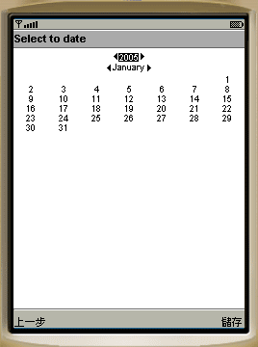
J2ME Overview - MIDP
Graphical user interface includes
  Included in javax.microedition.lcdui.*
  “Form” which conatins Basic items :
    ChoiceGroup -A ChoiceGroup is a group of selectable elements intended to be placed within a Form
    ImageItem –Hold an image for display
    StringItem – display text
    And some others like CustomItem, Gauge, DateField …
    Form is used for simple screen output and text input
A simple calendar application developed using Form

Slide 61
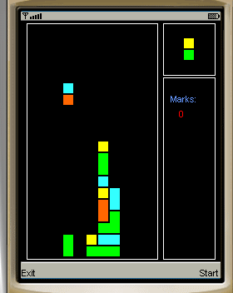
J2ME Overview - MIDP
  Canvas which contains Graphics
    Draw images and strings
    Draw rectangles, lines and arcs
    Set the color used
    Canvas also allows you to get “key” input from user
Form is used for some simple applications which only have text input
Canvas is used for more interactive applications like games
A puzzle game developed using Canvas

Slide 62
J2ME Overview - MIDP
Media
  Included in javax.microedition.media.*
  Allows playing of audio and video
  Allows control the playing of the media like the volume and tone of audio

Slide 63
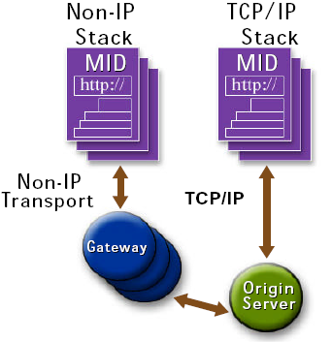
J2ME Overview - MIDP
Networking
  Included in javax.microedition.io.*
  MIDP devices must implement client portion of HTTP 1.1 protocol
May or may not use IP-based transport
  Non-IP Examples: HTTP layered on top of PDC-P for i-mode on WSP for WAP
IP is the protocol that we used in Internet

Slide 64
J2ME Overview - MIDP
Security
  Included in javax.microedition.pki.*
  Handling security certificate
  Allows you to get the public and perform encryption or verification

Slide 65
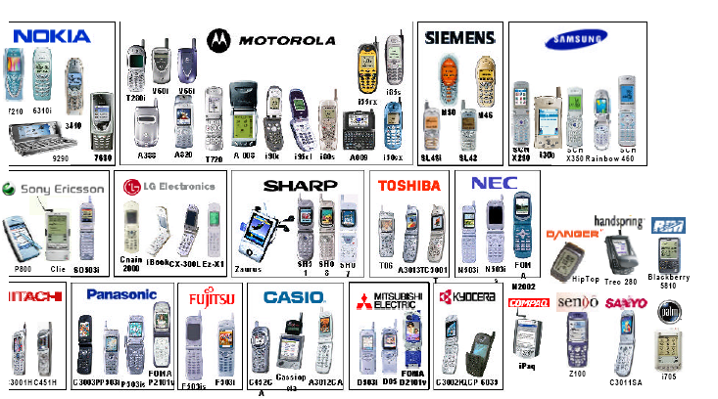
J2ME Resources
J2ME devices

Slide 66
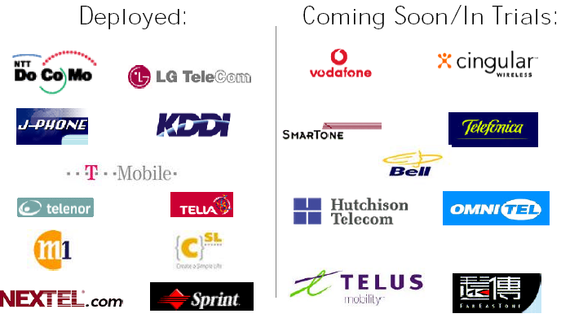
J2ME Resources
Key J2ME Deployments

Slide 67
J2ME Resources
J2ME Development Tools
  Sun J2ME Wireless Toolkit (SolarisTM platform, Linux, and Win32), standalone or plugged into Sun ONE Studio Mobile Edition IDE
  MIDP reference (Palm OS and Win32), CLDC SDK (Solaris platform, Linux, and Win32)
  Numerous third party tools (Borland/Nokia, Metrowerks/Motorola, Siemens, etc.)
  Any IDE or Java tool, including J2SE SDK
  Tools from the J2ME Archive (XML parsers and SOAP tools, J2ME-based microbrowsers, kAWT, etc.)

Slide 68
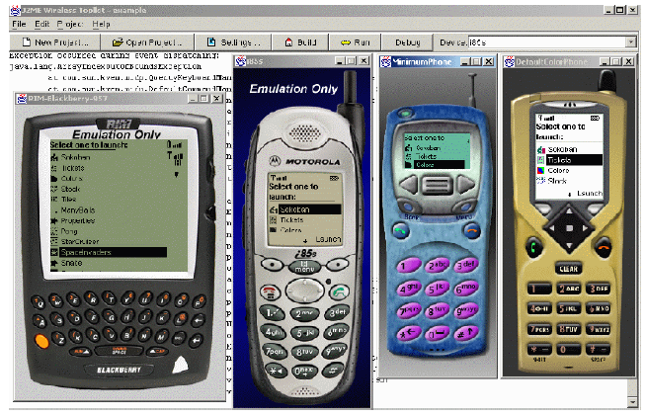
J2ME Resources
Sun J2ME Wireless Toolkit

Slide 69
J2ME Resources
Development Tools for the J2ME Platform
  Devices are available NOW
  Everything needed to start writing great Java applications for mobile devices is available TODAY
  Many of the best tools are FREE

Slide 70
WHY J2ME?
Different mobile devices utilize different platforms. An open platform is needed;
Many devices have no option to download and install software dynamically
Take advantages of Java language; But J2SE not realistic for mobile devices;
Over 20 million J2ME mobile phones produced in 2001. It is estimated that over 450 million J2ME mobile phones will be sold in 2007.
Java will be the dominant mobile terminals platform in the wireless sector.

Slide 71

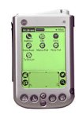


J2ME, J2SE and J2EE
Server, Workstations
PC, Notebook
J2ME API
J2EE
Nokia Communicator, set-top box net TV
Mobile Phones , PDAs
J2SE
MIDP
Profile Level
CDC
CLDC
Configuration Level
Java Virtual Machine
KVM
J2ME

Slide 72
J2ME Again ☺
To allow development of Java applications for devices that do not have the same processing power and memory found on a desktop platform. The devices may include cellular phones, PDAs, pagers, or others.
J2ME is divided into two broad categories, known as Configurations, Connected Devices Configuration (CDC) and Connected Limited Device Configuration (CLDC).
The Virtual Machine (KVM), which takes into consideration the limited resources available on devices that fit this configuration, was developed for the CDLC.
On top of Configurations are device Profiles, such as, Mobile Information Information Profile (MIDP) and the associated libraries, which are our main focus for this subject.

Slide 73
K Virtual Machine (KVM)
KVM was designed to be as small and efficient as possible, in order to support small resource constrained devices;
The runtime footprint is only about 60 Kilobytes;
The virtual machine will run in only a few tens of Kilo-bytes of memory.
Sun’s reference implementation of the KVM is written in C to facilitate portability.
The C codes can be downloaded.

Slide 74
Configurations
A Configuration defines a Java platform for a broad range of devices. In fact, it defines the Java language features and the core Java libraries of the JVM for particular Configurations;
The dividing line between the CDC and the CLDC depends on the memory, display, network connectivity and processing power available on a device;
The current division is shown in the next slide. But it will not be always be the case.

Slide 75
Two Configurations
CDC
512 KB (min.) memory for running Java
256 KB (min.) for runtime memory allocation
Network connectivity, possibly persistent and high bandwidth
CLDC
128 KB (min.) memory for running Java
32 KB (min.) for runtime memory allocation
Restricted user interface
Low power, typically battery powered
Network connectivity, typically wireless, with low bandwidth and intermittent access

Slide 76
Profiles
It’s all well and good that devices will fall within one Configuration or other. However, what seems limited to one device in a Configuration may be an abundance to another. Recall the analogy of cellular phone screen size versus that of a PDA;
To address this broad range of capacities, and to provide for more flexibility as technology changes, Sun introduced the concept of a Profile to the J2Me platform.
A Profile is an extension, if you will, to a Configuration. It provides the libraries for a developer to write applications for a particular type of device.
For example, the MIDP defines APIs for interface components, input and even handling, persistent storage, networking and timers, taking consideration the screen and memory limitation of mobile devices.

Slide 77
J2ME App. – a set of MIDlets
Downloading MIDlets either “Over Air” or cable, depends on manufacturers
JAR
JAD
J2ME SDK
J2ME
App.
Application Manager (software):
Install,
run and remove MIDlet;
It is device dependent.
MIDP
CLDC

Slide 78
J2ME Application – a set of MIDlets and other files
General
Application
MIDlet
MIDlet Suite
MIDP
CLDC
Java Archive File(JAR)
Java Application
Descriptor (JAD)
Simplest Application with only one MIDlet
MIDlet - Java Classes
Resources, images
Manifest file

Slide 79
MIDlet application model
Defines the concept of an application in MIDP environment
javax.microedition.midlet
Every application must be a subclass of class MIDlet
  constructor
  startApp()
  pauseApp()
  destroyApp()
In many cases, one also implements interface CommandListener

Slide 80
MIDlet states
Unborn
constructor
destroyApp
startApp
Paused
Active
pauseApp
Created

Slide 81
Sample code: HelloMIDlet
import javax.microedition.midlet.*;
import javax.microedition.lcdui.*;
import java.util.*;
public class HelloWorld extends MIDlet implements CommandListener {
private Command exitCommand;
private TextBox tb;
public HelloWorld() {
exitCommand = new Command("exit", Command.EXIT, 1);
tb = new TextBox("HelloWorld", "Hello world!", 15, 0);
tb.addCommand(exitCommand);
tb.setCommandListener(this);
}
protected void startApp() {Display.getDisplay(this).setCurrent(tb);}
public void commandAction(Command c, Displayable d) {
if (c== exitCommand) { destroyApp(false); notifyDestroyed();}
}
protected void destroyApp(boolean u) {}
protected void pauseApp() {}
}

Slide 82
MIDlet suites
Applications are represented publicly as JAR files
  Class files
  Resource files
  Manifest that describes the JAR contents
Multiple MIDlets can reside in the same JAR file
  MIDlet suite
  Applications can share data only with those applications that are in the same MIDlet suite
  Therefore MIDlet design is an important architectural decision when aiming at larger systems
Each MIDlet suite has a short textual descriptor file
  A device user does not have to download the entire application before knowing if it will actually run in the device
  JAD file with the contents that are (almost) identical with JAR manifest

Slide 83
JAD/JAR manifest contents
MIDlet-Name --- MIDlet suite name
MIDlet-Version
MIDlet-vendor
MIDlet-Icon
MIDlet-Info-URL
MIDlet-<n> --- name, icon and class per midlet
MIDlet-Jar-URL
MIDlet-Jar-Size
MIDlet-Data-Size
MicroEdition-profile --- J2ME profile
MicroEdition-Configuration --- J2ME configuration

Slide 84
Example: JAD/JAR manifest of a simple application
MIDlet-1: HelloWorld, /HelloWorld.png, HelloWorld
MIDlet-Jar-Size: 2179
MIDlet-Jar-URL: HelloWorld.jar
MIDlet-Name: HelloWorld
MIDlet-Vendor:
MIDlet-Version: 1.0
MicroEdition-Configuration: CLDC-1.0
MicroEdition-Profile: MIDP-1.0

Slide 85
MIDlet suite execution
Classes and native code that implement CLDC and MIDP
  Only shared name space for all MIDlet suites
Classes within MIDlet suite’s JAR file
All non-class files in the MIDlet’s suite’s JAR file
  Icons, images, JAR manifest
  Accessible with java.lang.Class.getResourceAsStream
Contents of Application Descriptor File
  Accessible with java.lang.Class.getResourceAsStream
Separate name space for RMS record stores

Slide 86
Application: MathHangman
Simple MIDP Application
Takes around 1 hour to build
Puzzle type
Next slide shows the process flow/behaviour
Uses basic MIDP components and J2ME packages
  i.e. javax.*

Slide 87
Behavior
start
App
command
Action
check
Command
pick
Equation
draw
Equation
user

Slide 88
import javax.microedition.midlet.*;
import javax.microedition.lcdui.*;
public class mathHangman extends MIDlet implements CommandListener {
private Command exitCommand, rightCommand, wrongCommand;
private TextBox tb; /* Quiz canvas */
private int nth; /* Counter for equation and answer pair. */
String Questions[] = /* Questions */
{ "1 + 3 = 4",
"3 + 12 = 14",
"12 + 7 = 19",
"4 + 9 = 12",
"1 + 2 = 3",
"2 + 12 = 15",
"3 + 12 = 15",
"12 + 2 = 13",
"10 + 5 = 15",
"12 + 5 = 16" };
int Qlen = Questions.length;

Slide 89
public mathHangman() {
exitCommand = new Command("exit", Command.EXIT, 1);
wrongCommand = new Command("WRONG", Command.CANCEL, 2);
rightCommand = new Command("RIGHT", Command.OK, 3);
}
protected void startApp() { pickEquation(); }
protected void destroyApp(boolean u) {}
protected void pauseApp() {}
public void commandAction(Command c, Displayable d) {
if (c == exitCommand) {
destroyApp(false);
notifyDestroyed();
} else ( checkCommand(c == rightCommand);
} // else
}

Slide 90
private void pickEquation(){ displayEquation(Questions[nth]);}
private void displayEquation(String equation) {
tb = new TextBox(”mathHangman", equation, 15, 0);
tb.addCommand(wrongCommand);
tb.addCommand(rightCommand);
tb.setCommandListener(this);
Display.getDisplay(this).setCurrent(tb);
}

Slide 91
private void checkCommand(boolean b) {
if(((nth%2) == i) = b) {
tb = new TextBox("mathHangman",
"You failed the challenge", 30, 0);
tb.addCommand(exitCommand);
tb.setCommandListener(this);
Display.getDisplay(this).setCurrent(tb);
} else {
nth = nth + 1;
if (nth == Qlen) {
tb = new TextBox("mathHangman",
"You mastered the challenge", 30, 0);
tb.addCommand(exitCommand);
tb.setCommandListener(this);
Display.getDisplay(this).setCurrent(tb);
} else {
pickEquation();
}
}
}
} // class mathHangman

Slide 92
J2ME WTK Installation

